Slide 1
PEPFAR’s Sustainability Index and Dashboard: Results from SID 3.0
Christopher A. Hart, Michael Ruffner, Janis Timberlake, Matt Wollmers
Office of the U.S. Global AIDS Coordinator and Health Diplomacy
U.S. Department of State
July 25, 2018

Slide 2
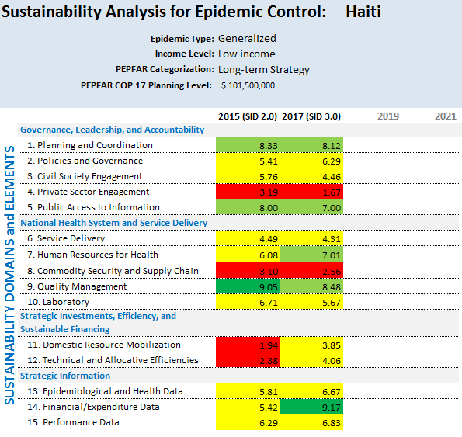
What is the SID?
Helps partner country governments and other stakeholders assess the current state of national HIV/AIDS responses while identifying strengths and vulnerabilities.
Provides essential data used to determine health systems investments and metrics to track the impact of investments over time.
Serves as a health diplomacy tool for engaging partner governments.

Slide 3
Findings
12 of 13 countries close to epidemic control showed significant improvement in SID scores.
p < 0.001 using Student’s t-test

Slide 4
Findings
Middle income countries generally scored better than low income countries.
The greatest discrepancies were in elements related to national health systems and financing.
p < 0.001 using Student’s t-test

Slide 5
Conclusions
Despite persistent differences, overall SID scores are moving toward greater sustainability across PEPFAR-supported countries.
Progress in 13 countries close to epidemic control demonstrates that through targeted effort and investments, countries can build more sustainable national health systems.
The SID is a valuable tool to assess sustainability, but deeper analysis is needed to determine what countries are currently spending on interventions and what they should cost.

Slide 6
THANK YOU!
SID results are available at: https://www.pepfar.gov/countries/cop/sids/index.htm

